Slide 1
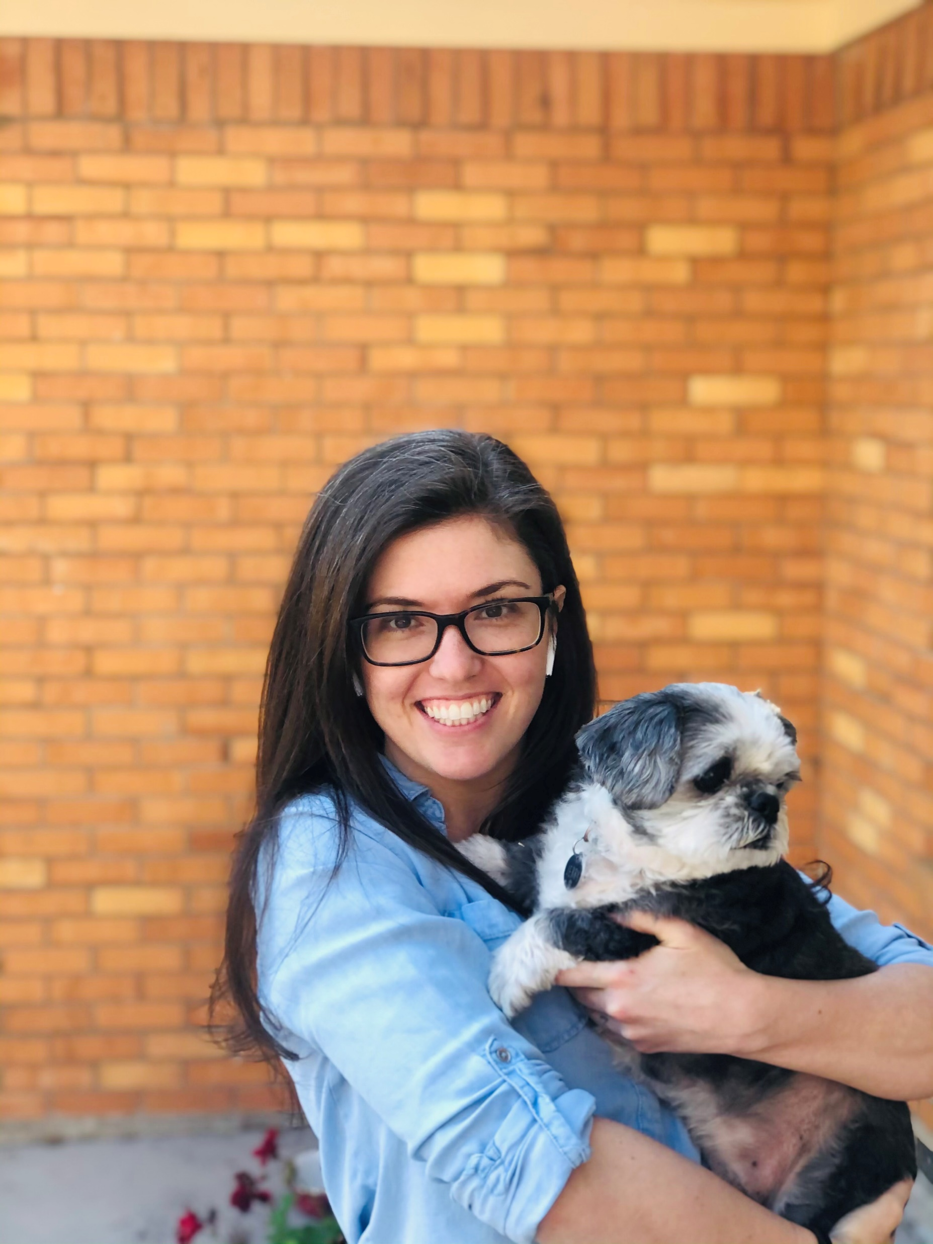
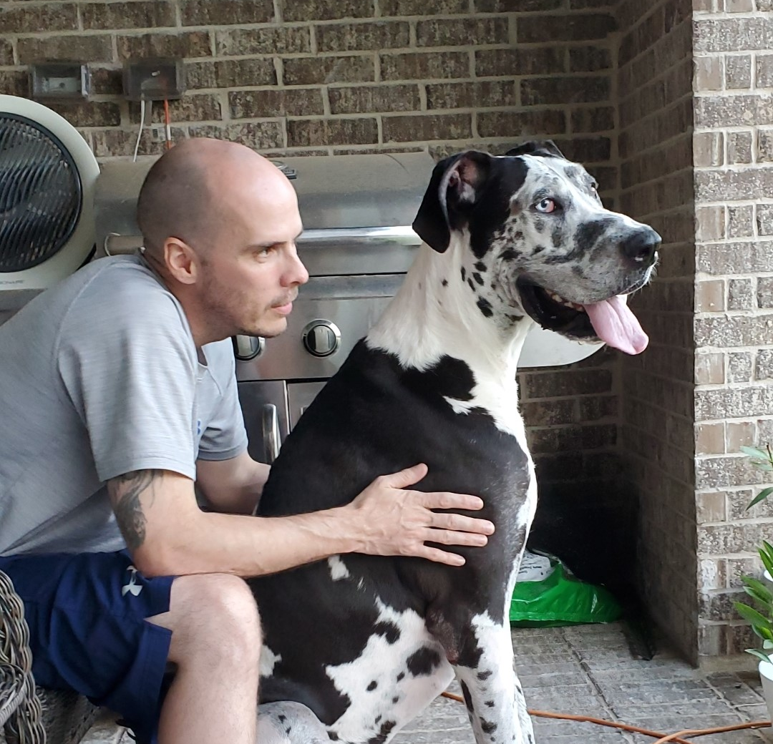
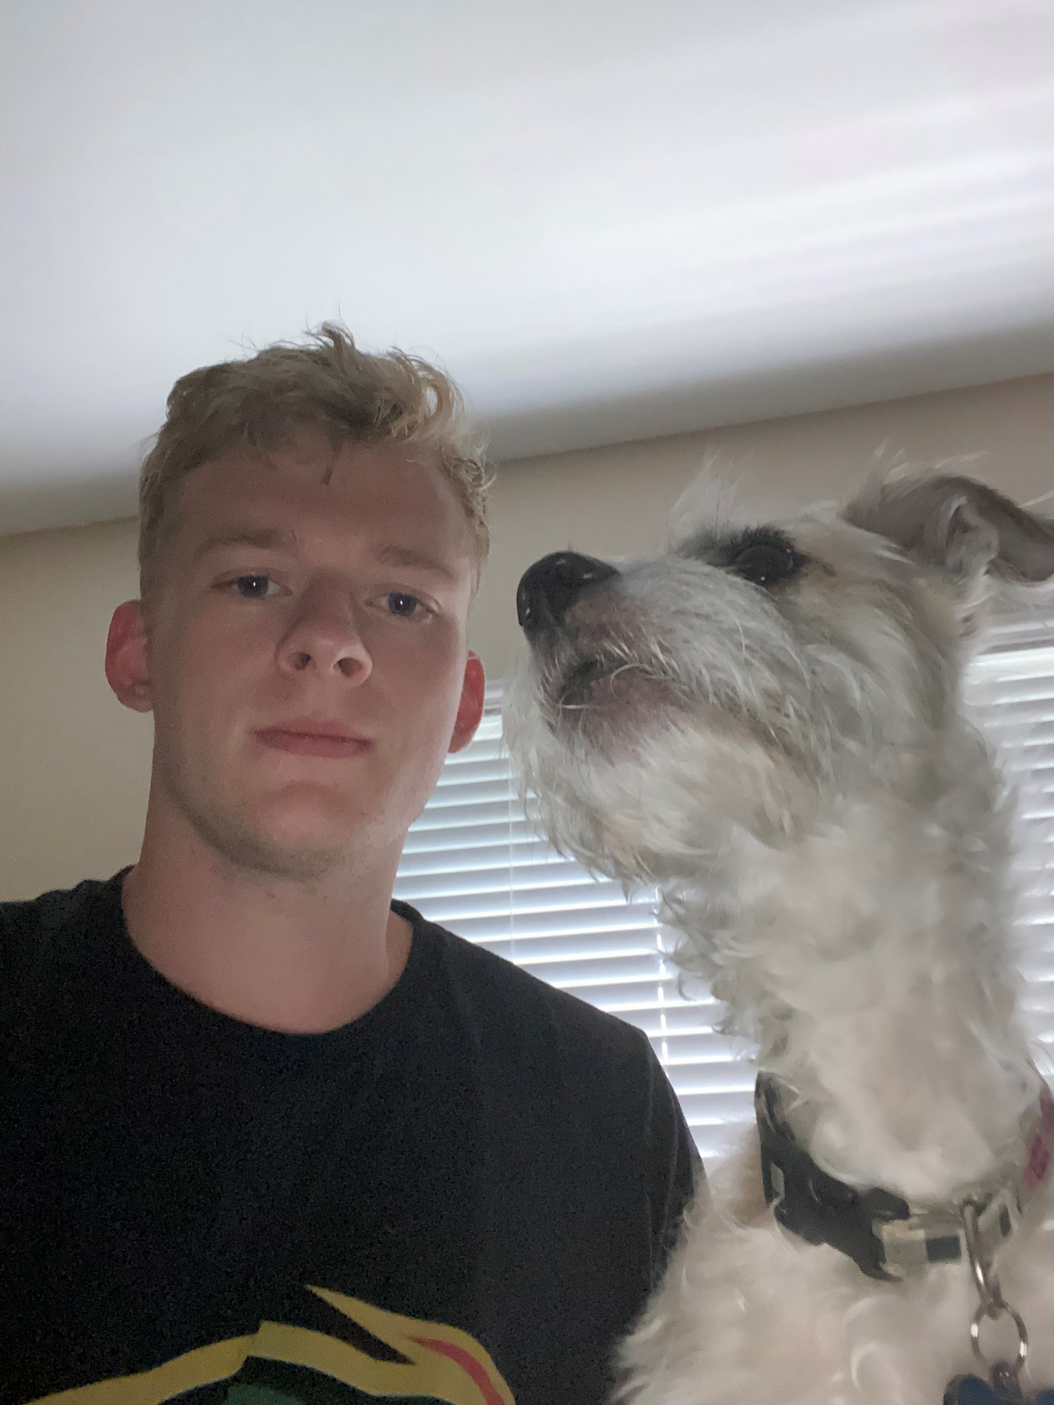
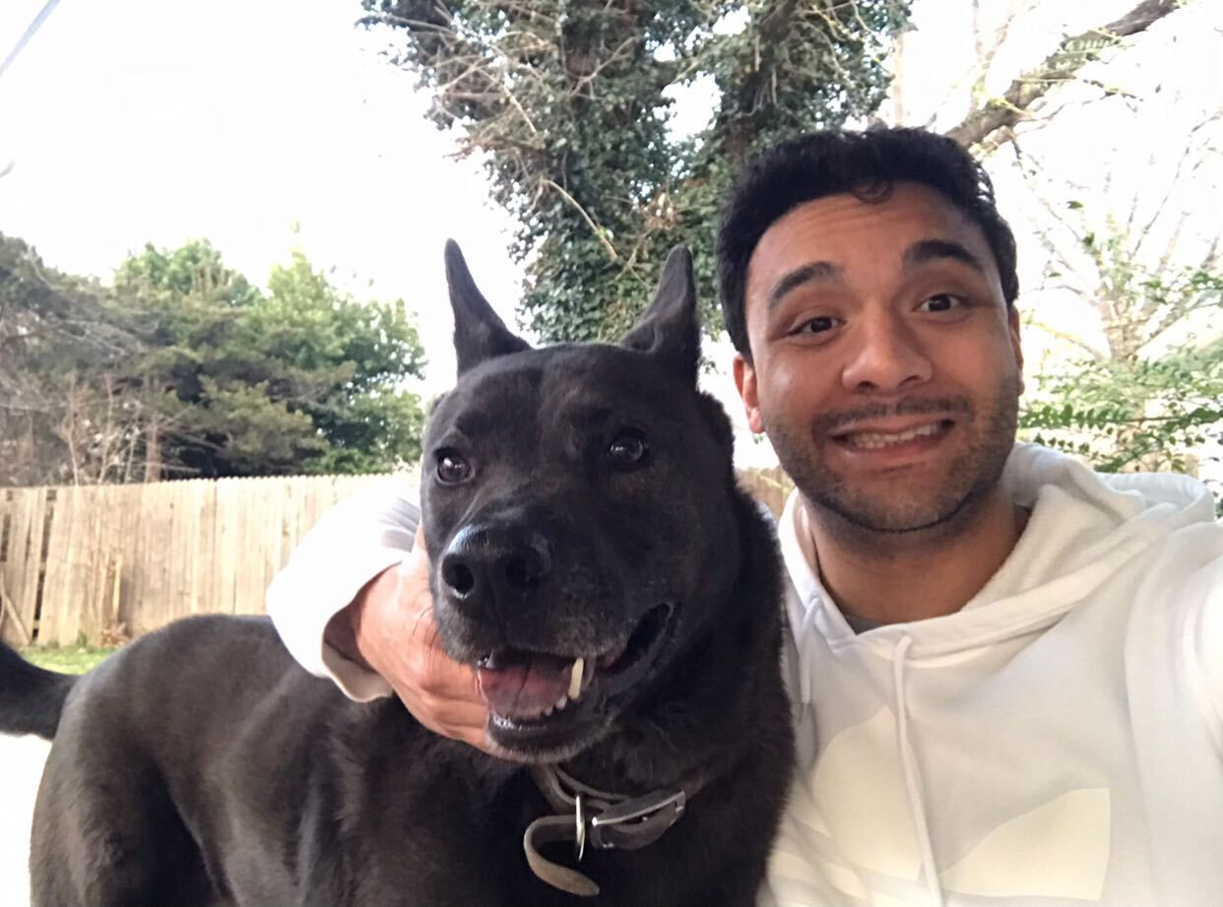
Austin Animal shelter data page
Kelli Smith, Jonathan Arnold, Greyson moore and lucas da silva

Slide 2


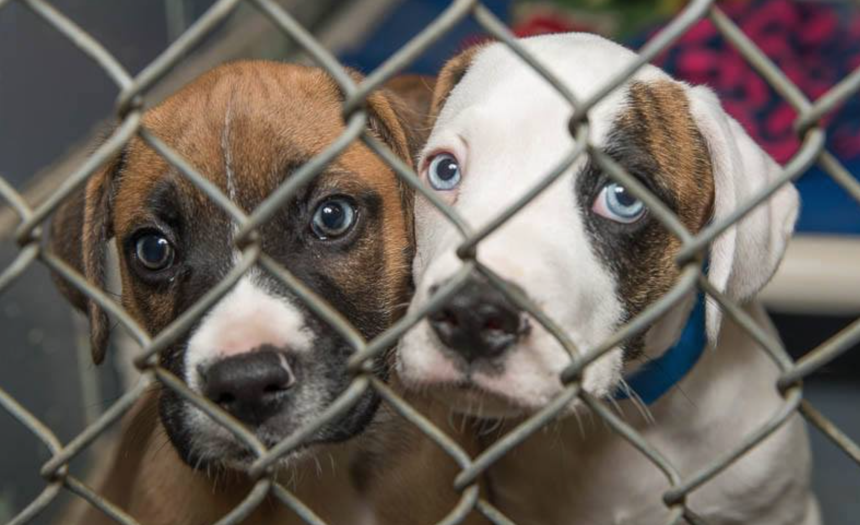
Inspiration
As awareness about animal wellbeing grows, the concern with animal shelters and stray animals grows as well. Many campaigns have been created to promote the adoption of pets versus purchasing them, but what do we know about pets available for adoption?

Slide 3

What are we trying to accomplish?
Our team compiled and sorted data from the city of Austin about their animal shelters to try to better understand the profile of these animals. We tried to analyze what kind of animals can be found in shelters and where do they come from, so that any person looking to adopt may have an easier time finding an animal that they love.
Additionally, this site can be used as a resource for animal shelters and local governments for management purposes.

Slide 4

data
We wanted to use data from the city of dallas, but we struggled to find a data set that contained geo location, breed, type of animal and everything else we needed for the website. turns out Austin, tx, had the perfect data set.
https://github.com/chris-krokus/Project-3-Group-4/tree/master/Resources

Slide 5

Color scheme
According to journal of the American veterinary medical association, dogs do see colors. They can see blues, yellows and shades of gray (a spectrum of color similar to humans who are red-green colorblind). So, we decided to use those colors in case your dog wants to help you find another pet.
Vision in dogs - PubMed (nih.gov)

Slide 6
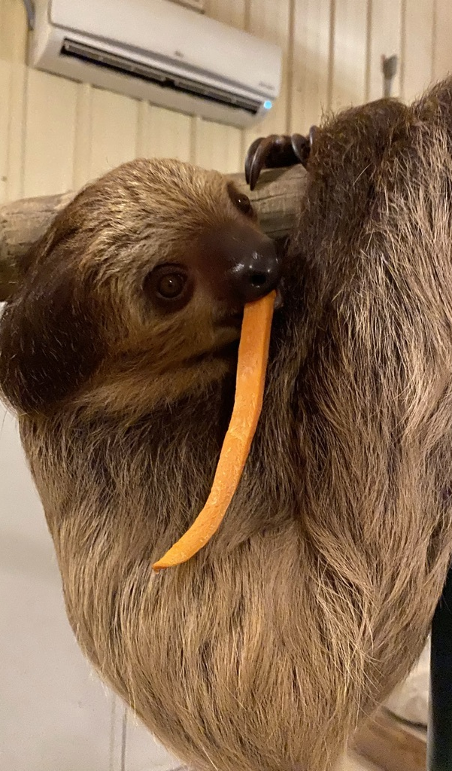
Difficulties, struggles and hiccups
Finding a data set that contained consistently current information about animals being taken into the shelters.
Filtering and cleaning the data set, which contained 70,000+ rows
Getting the geo (lat/long) data to load on the maps.
Getting visuals to load to the website once it’s hosted on github

Slide 7
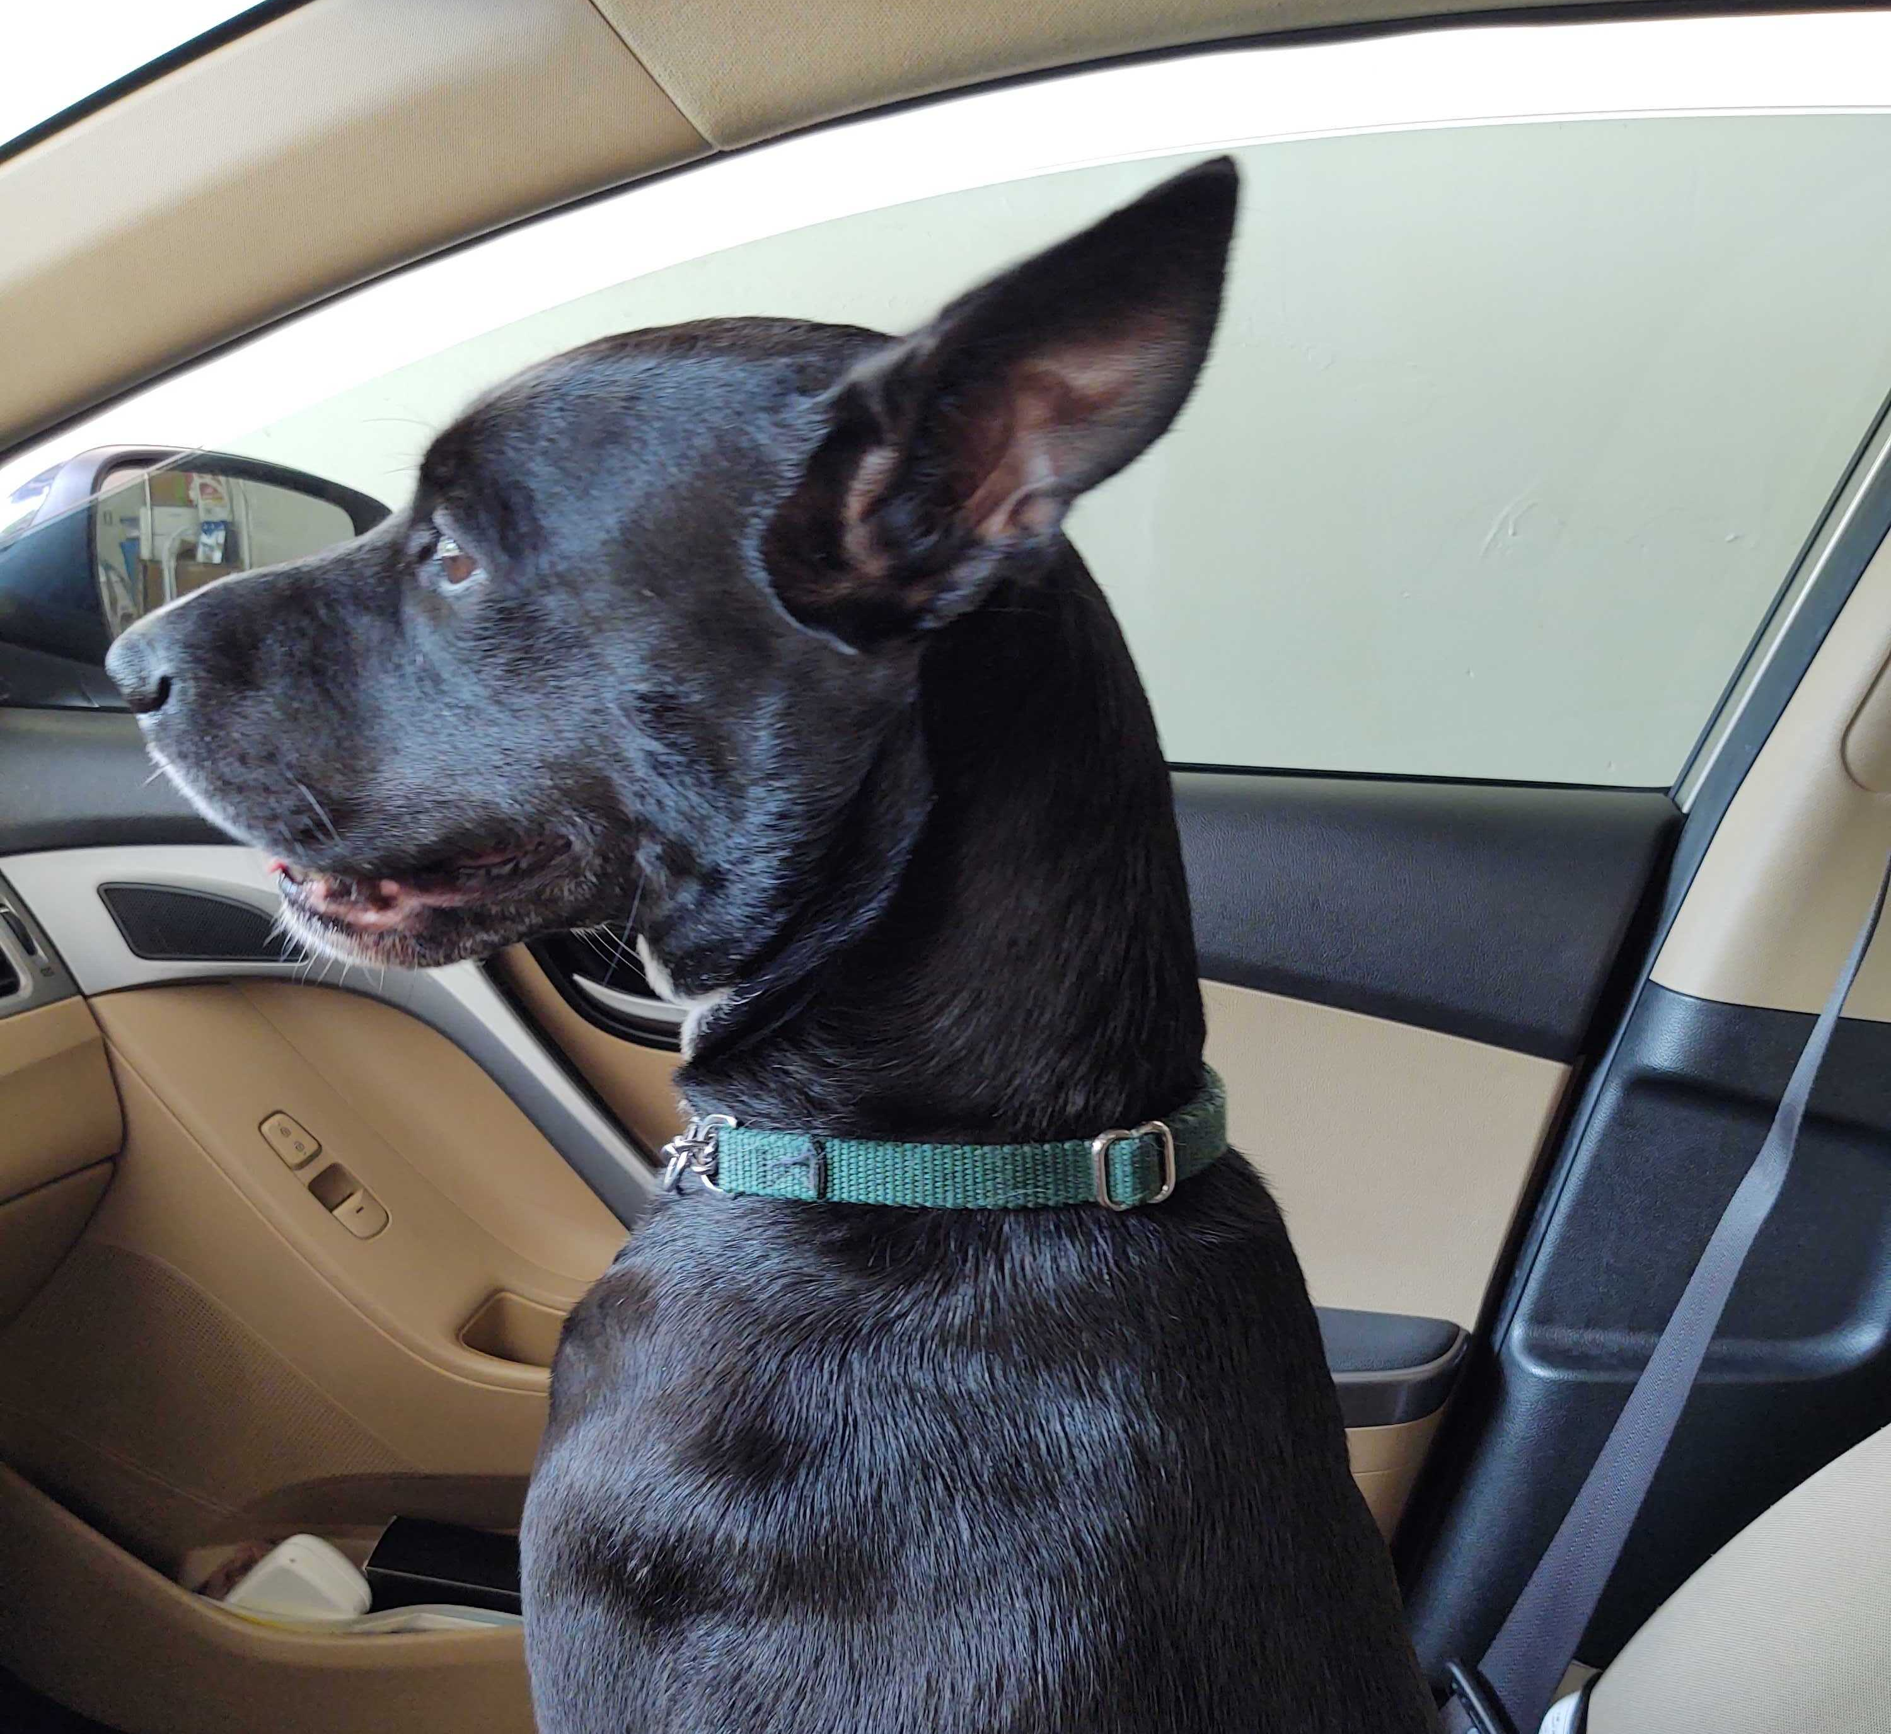
takeaways
Over the 4 years analyzed we saw consistent trends of Outcome Type vs Income Type trends
Stray was the primary intake type cited across all 4 years, followed by Owner Surrender and Public Assist.
Depending on the year analyzed
Strays - the two highest outcomes were Adoption (41-51%) and Return to Owner (28-31%)
Owner Surrender- the two highest outcomes were Adoption (41-51%) and Transfers (28-31%)
Public Assist - the two highest outcomes were Return to Owner (70-80%) and Transfers (20% in 2017) and Adoption (9-11% 2014-2016)

Slide 8
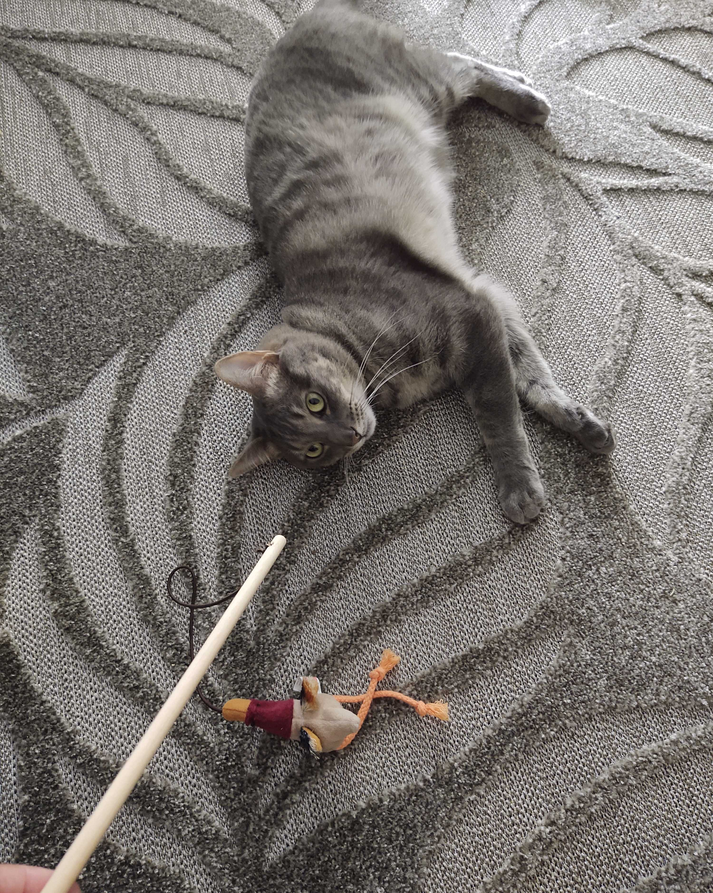
Takeaways (continued)
Breeds
For dogs, every year during the period analyzed, the top three breeds in shelters were: pit bull mix, Labrador retriever mix and chihuahua mix
German shepherd mix and Australian cattle dog mix were 4th and 5th also every year analyzed
for cats, every year during the period analyzed, the top three breeds in shelters were: domestic short, medium and longhair mixes
Siamese was 4th in all years analyzed

Slide 9
Future work and limitations
Future Work
Incorporating filters by animal type, breed, animal shelter contact information on the map
More in depth visualizations with D3 and other sources
Site enhancements
Limitations
Data was limited to 2014 -2017
Data entries included some addresses that could not be converted to lat/lng properly
Unproven data points such as time in shelter, condition upon intake, reasons for pick up, etc.

Slide 10
Website demonstration
https://kellidsmith.github.io/SMU_Project3_Group2/Website%20-%20Copy/dashboard.html

Slide 11
Thank you

